Slide 1
Lecture 18 Yet more GUI programming
D&D 12

Slide 2
Goals
By the end of this lesson, you should:
Be able to write Java applications with mouse input
Be able to write Java applications that dynamically add and remove event listeners
Be able to write Java applications that position GUI components at absolute positions
Be able to implement anonymous inner classes
Disclaimer: No living mosquitoes were harmed in the development of the application for this lecture. Any similarity between real mosquitoes and the mosquitoes in this application are purely coincidental. The application should not be taken as an endorsement of mosquito hunting. The use of fly swatters carries some risk to life, health and property, especially if applied while standing on furniture. Permanent damage and or surface discolouration may occur at the swatted spot. Do not use your tablet, cellphone or laptop as a fly swatter. We assume no responsibility for any injury or loss resulting from attempted mosquito hunting.

Slide 3
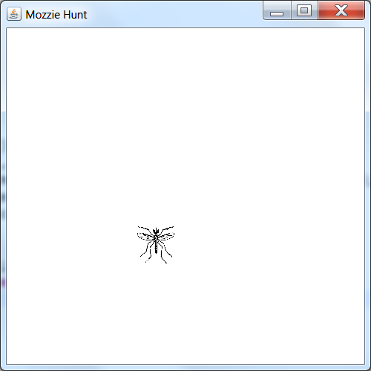
The MozzieHunt application
The application
Startup
Imports
Overview
Methods
Anonymous inner classes
Summary
JPanel
JLabel with ImageIcon

Slide 4
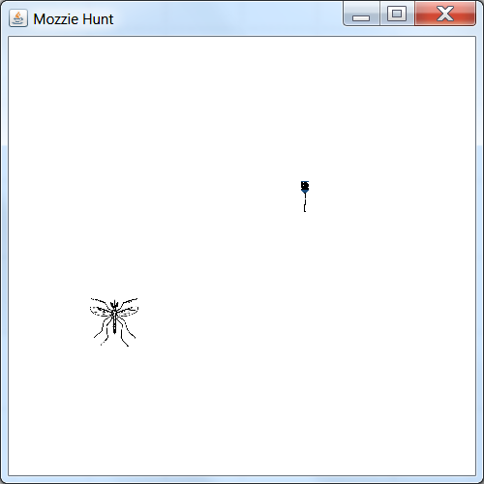
The MozzieHunt application
The application
Startup
Imports
Overview
Methods
Anonymous inner classes
Summary
Cursor with custom image (fly swatter)
Move the fly swatter over the mozzie and
click to swat… if you can!

Slide 5
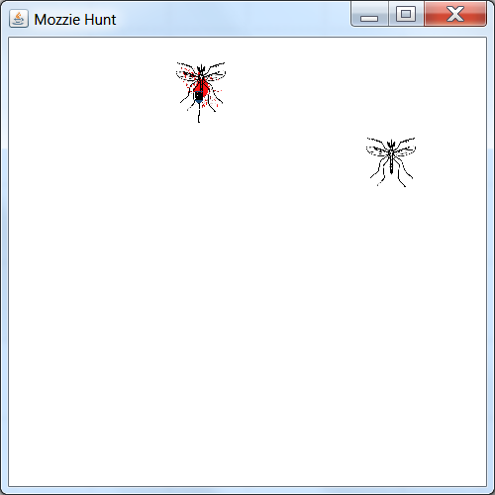
The MozzieHunt application
The application
Startup
Imports
Overview
Methods
Anonymous inner classes
Summary
Gotcha!
@$%&#! Oh no! Another one!
Move the fly swatter over the mozzie and
click to swat… if you can!
JLabel with ImageIcon (with transparent background colour) gives the blood splat

Slide 6
The MozzieHunt application
The application
Startup
Imports
Overview
Methods
Anonymous inner classes
Summary
It all works like this:
We randomly place a mosquito (a JLabel with an ImageIcon) on the JPanel that serves as our playing surface.
The mosquito image’s background colour is set to transparent (so we can have mosquitos overlap)
We replace our cursor with a custom image showing a fly swatter. Again, this image has a transparent background (normal for cursors – or you’d see square boxes as cursors on your screen)
When the cursor moves over the mosquito JLabel, it dispatches a mouse move event. We then check whether the cursor was previously off the label.
If yes, the mosquito gets a (four in five) chance to jump to a new random position.
If no, the mosquito stays where it is.
If we have the cursor over the mosquito JLabel, we can click on it – another event.
If our cursor leaves the mosquito (another event again), the mosquito gets a new chance to jump when we move the cursor over it again.
Once we have clicked on a mosquito, we place the splat JLabel (also with a transparent background) over the top of the mosquito.
We then remove the event handlers from the present mosquito and create new mosquito and splat JLabels for another round.

Slide 7
Application startup
The application
Startup
Imports
Overview
Methods
Anonymous inner classes
Summary
import javax.swing.SwingUtilities;
public class RunMozzieHunt implements Runnable {
public void run() {
MozzieHunt m = new MozzieHunt();
}
public static void main(String[] args) {
SwingUtilities.invokeLater(new RunMozzieHunt());
}
}
Nothing new here I hope!
Note: Eclipse users – in order for this application to run properly, you must copy the PNG images into the bin folder of your Eclipse workspace!

Slide 8
Imports in MozzieHunt
The application
Startup
Imports
Overview
Methods
Anonymous inner classes
Summary
import java.awt.Point;
import java.awt.Graphics;
import java.awt.event.MouseEvent; // describes all mouse events
import java.awt.event.MouseAdapter; // clicks and component exits
import java.awt.event.MouseMotionAdapter; // mouse moves
import java.awt.Image;
import java.awt.Color;
import java.awt.FlowLayout;
import java.awt.Toolkit; // needed for custom cursor image
import java.awt.Cursor; // needed for custom cursor image
import java.awt.Dimension;
import javax.swing.JFrame;
import javax.swing.JLabel;
import javax.swing.ImageIcon;
import javax.swing.JPanel;
No big surprises here either – new are the mouse event related imports and the toolkit & cursor related classes. These give us the fly swatter.

Slide 9
The fields in MozzieHunt
The application
Startup
Imports
Overview
Methods
Anonymous inner classes
Summary
public class MozzieHunt extends JFrame {
private JPanel panel;
private JLabel mozzie;
private JLabel splat;
private boolean mouseOffMozzie;
…
The panel allows us to position the mozzies and the splats.
mozzie references the JLabel with the mosquito we currently hunt.
splat references the next splat to place once we manage to click on mozzie.
Finally, mouseOffMozzie indicates whether the mouse is currently on or off the currently hunted insect. As our event listener for the mouse move gets called whenever the mouse moves over mozzie, we need a way of determining when it first moves onto the label (as this is what causes the mozzie to “fly away”).

Slide 10
The rest of the class
The application
Startup
Imports
Overview
Methods
Anonymous inner classes
Summary
The constructor MozzieHunt() sets up the GUI with the help of two private convenience methods that create JLabels with mosquitoes an blood splats.
Event handling happens exclusively in anonymous inner classes.
These classes implement a MouseAdapter and a MouseMotionListener, respectively. This is new.
MouseAdapter and a MouseMotionListener implement interfaces with various event listener methods – but the implementation of these methods doesn’t actually do anything!
By implementing the classes as anonymous inner classes, we can override those do-nothing event listener methods we want to use with versions that actually do something – without having to re-implement all other methods of the interfaces as well.

Slide 11
MozzieHunt()
The application
Startup
Imports
Overview
Methods
Anonymous inner classes
Summary
public MozzieHunt() {
super("Mozzie Hunt");
setLayout(null);
setSize(500,500);
setDefaultCloseOperation(JFrame.EXIT_ON_CLOSE);
panel = new JPanel();
panel.setLayout(null);
panel.setOpaque(true);
panel.setBackground(Color.WHITE);
setContentPane(panel);
createMozzie(); // first mozzie
createSplat(); // first blood splat
mouseOffMozzie = true;
ImageIcon swat = new
ImageIcon(getClass().getResource("flyswat.png"));
Image sw = swat.getImage();
Toolkit toolkit = Toolkit.getDefaultToolkit();
Dimension cursorSize = toolkit.getBestCursorSize(300, 300);
Cursor c = toolkit.createCustomCursor(sw,
new Point(cursorSize.width/2, cursorSize.height/4), "flyswat");
panel.setCursor(c);
setVisible(true);
}

Slide 12
createMozzie()
The application
Startup
Imports
Overview
Methods
Anonymous inner classes
Summary
private void createMozzie() {
mozzie = new JLabel("", JLabel.CENTER);
ImageIcon moz = new ImageIcon(getClass().getResource("mozzie.png"));
Image img = moz.getImage(); // get image out of moz ImageIcon
img = img.getScaledInstance(50, 50, Image.SCALE_DEFAULT); // scale it
moz.setImage(img); // store it back in the ImageIcon
mozzie.setIcon(moz); // set icon on label to use the moz ImageIcon
mozzie.setSize(50,50); // set the label size to that of the image
int width = this.getWidth(); // find width and height of application
int height = this.getHeight(); // to use in random mozzie placement
int x = (int) (Math.random() * width * 0.6 + width * 0.2); // mozzie x
int y = (int) (Math.random() * height * 0.6 + height * 0.2); // mozzie y
mozzie.setLocation(x, y); // move mozzie top left corner to x, y
mozzie.addMouseListener(
new MouseAdapter() {
// see separate slide for what goes here
}
);
mozzie.addMouseMotionListener(
new MouseMotionAdapter() {
public void mouseMoved(MouseEvent e) {
// see separate slide for what goes here
}
}
);
panel.add(mozzie);
}

Slide 13
MouseAdapter()
The application
Startup
Imports
Overview
Methods
Anonymous inner classes
Summary
public void mouseClicked(MouseEvent e) {
// We've clicked on the mozzie!
int x = mozzie.getX(); // get mozzie position so…
int y = mozzie.getY();
splat.setLocation(x, y); // … we can position the splat
splat.setVisible(true);
splat.repaint();
// New game – remove event listeners from current mozzie
mozzie.removeMouseListener(mozzie.getMouseListeners()[0]);
mozzie.removeMouseMotionListener( mozzie.getMouseMotionListeners()[0] );
// Create the next mozzie (and its event listeners)
createMozzie();
mozzie.repaint();
createSplat();
// Make sure it has a chance to move if we move
mouseOffMozzie = true; }
public void mouseExited(MouseEvent e) {
mouseOffMozzie = true;
}

Slide 14
MouseAdapter()
The application
Startup
Imports
Overview
Methods
Anonymous inner classes
Summary
The MouseAdapter class is an abstract class that implements a whole range of event listener interfaces having to do with mouse events – but not all interfaces.
It implements all methods of the event listener interfaces that it implements.
While the class is abstract, its methods are not – but they just return and provide no other functionality.
In the anonymous class, we override those methods of the abstract class that we need, in this case mouseClicked() and mouseExited() with versions that have actual functionality.
The other methods from MouseAdapter are still there, however, so we only need to implement those methods we want to use.
MouseAdapter is an example of a convenience class.
MouseMotionAdapter works in the same way, but implements different interfaces.

Slide 15
MouseMotionAdapter()
The application
Startup
Imports
Overview
Methods
Anonymous inner classes
Summary
new MouseMotionAdapter() {
public void mouseMoved(MouseEvent e) {
// Determine whether to move the label away
if (Math.random() > 0.2 && mouseOffMozzie) {
// Yes, move in 80% of cases
int width = MozzieHunt.this.getWidth();
int height = MozzieHunt.this.getHeight();
int x = mozzie.getX();
int y = mozzie.getY();
int newx, newy;
// Try to find new coordinates at a safe distance
do {
newx = (int) (Math.random() * (width - 50));
newy = (int) (Math.random() * (height - 50));
} while (newx + 50 >= x && newx <= x + 50
&& newy + 50 >= y && newy <= y + 50);
mozzie.setLocation(newx, newy);
mozzie.repaint();
}
else
{
mouseOffMozzie = false;
}
}
}

Slide 16
createSplat()
The application
Startup
Imports
Overview
Methods
Anonymous inner classes
Summary
private void createSplat() {
splat = new JLabel("", JLabel.CENTER);
ImageIcon spl = new ImageIcon(getClass().getResource("splat.png"));
Image s = spl.getImage();
s = s.getScaledInstance(50, 50, Image.SCALE_DEFAULT);
spl.setImage(s);
splat.setIcon(spl);
splat.setSize(50, 50);
splat.setVisible(false);
panel.add(splat);
}

Slide 17
Anonymous inner classes
The application
Startup
Imports
Overview
Methods
Anonymous inner classes
Summary
An anonymous inner class is a class we instantiate on the spot – so it doesn’t need a name. This is what it consists of:
The keyword new takes care of immediate instantiation.
This is followed by either
a constructor call to the constructor of a class we wish to extend as the anonymous class (e.g., MouseAdapter), including any arguments to the constructor, or
the name of an interface that the anonymous class will implement, followed by a set of empty round parentheses ().
This is followed by the body of the (anonymous) class declaration in curly braces {}.
The only static members allowed in the body are constants.

Slide 18
Anonymous inner classes
The application
Startup
Imports
Overview
Methods
Anonymous inner classes
Summary
A number of rules apply:
Each anonymous inner class is by definition instantiated by the code of an outer class C (or instance c).
All members (public, protected or private) of the outer class are in scope in the methods of the anonymous inner class (but may be shadowed there by local variables as usual).
Note that the keyword this in the body of the anonymous inner class refers to the instance of the anonymous inner class, not to that of the outer class.
If we need access to the this of the outer instance, it’s easy: C.this

Slide 19
What do we know
The application
Startup
Imports
Overview
Methods
Anonymous inner classes
Summary
A GUI that needs graphical objects with a lot of detail can often be achieved using rectangular icons with transparent background colours.
We can position JComponents on a JPanel at absolute positions if we set the layout manager to null.
Mouse event listeners can be added to components, so we only handle mouse clicks, moves, etc. when the mouse interacts with the component.
Anonymous inner classes let us extend abstract classes such as MouseAdapter and MouseMotionAdapter to implement just the handler methods we need by overriding dummy methods of the same name in the abstract class.
We can remove event listeners from components.

Slide 20
Resources & Homework
The application
Startup
Imports
Overview
Methods
Anonymous inner classes
Summary
D&D Chapter 12
https://docs.oracle.com/javase/8/docs/api/java/awt/event/MouseAdapter.html
https://docs.oracle.com/javase/8/docs/api/java/awt/event/MouseMotionAdapter.html
https://docs.oracle.com/javase/tutorial/java/javaOO/anonymousclasses.html
Homework:
Add a label to the application that tracks the number of mozzies you hit
Advanced challenge: Replace the cursor image by a wholly transparent image and implement a JLabel with an ImageIcon showing the fly swatter that follows the (invisible) mouse pointer.

Slide 21
Next Lecture
Strings and regular expressions (Chapter 14)

